Slide 1
Terraform

Slide 2
Overview
Terraform is a powerful open-source Infrastructure as Code (IaC) tool developed by HashiCorp.
It enables users to describe and provision infrastructure resources in a declarative manner.
This means that instead of specifying a sequence of steps to achieve a desired infrastructure state, users declare the desired state of their infrastructure, and Terraform figures out the steps to make it so.

Slide 3
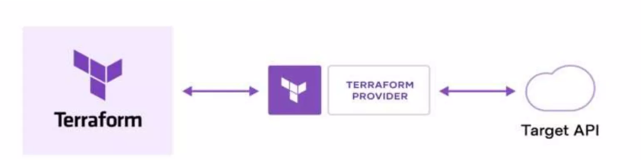
How does Terraform work?
Terraform creates and manages resources on cloud platforms and other services through their application programming interfaces (APIs).
Providers enable Terraform to work with virtually any platform or service with an accessible API.

Slide 4
Key Features
Declarative Configuration | Terraform uses a declarative syntax, allowing users to describe the infrastructure they want rather than specifying how to achieve it
Multi-Cloud Support | Terraform is cloud-agnostic and supports multiple cloud providers, including AWS, Azure, Google Cloud, and others. This flexibility allows users to manage infrastructure across different platforms using a single tool.
Resource Provisioning | Users define resources and their configurations in Terraform scripts. These scripts, written in HashiCorp Configuration Language (HCL), describe the desired infrastructure components, such as virtual machines, networks, databases, and more.
State Management: | Terraform maintains a state file that records the current state of the infrastructure. This state file is used to plan and apply changes, ensuring that Terraform can accurately determine what changes are needed to achieve the desired configuration.
Modularity and Reusability | Terraform configurations are modular, allowing users to break down their infrastructure code into reusable modules. This promotes code organization, collaboration, and the creation of standardized infrastructure components.

Slide 5
HCL (HashiCorp Configuration Language)
HCL is a configuration language created by HashiCorp for use with their infrastructure management tools, including Terraform. It is designed to be both human-readable and machine-friendly.

Slide 6
Key Features
Declarative Syntax
Focuses on "what" needs to be achieved rather than "how" to achieve it
Blocks and Nesting
Configuration files are structured into blocks, each representing a resource or configuration element.
Blocks can be nested, facilitating the representation of relationships and dependencies between different resources.

Slide 7
Key Features – Cont..
Attributes
Within blocks, attributes define specific settings or parameters for resources.
Customizable attributes allow users to tailor configurations based on the unique requirements of the infrastructure.
Variables
HCL supports the use of variables, enabling the reuse and parameterization of values throughout the configuration.
Variables can be defined and assigned values within the configuration, enhancing flexibility and maintainability.

Slide 8
Key Features – Cont..
Expressions
HCL incorporates expressions for dynamic configuration.
These expressions empower users to perform calculations, manipulate strings, and make decisions based on conditions within the configuration.
Comments
HCL supports both single-line (#) and multi-line (/* */) comments.
Comments are valuable for documentation, providing explanatory notes, and enhancing the overall readability of the configuration code.

Slide 9
Terraform init
terraform init is a command used in Terraform to initialize a working directory.
Terraform looks for the main configuration file (main.Tf) and other supporting files like variables.Tf and outputs.Tf.
Terraform init initializes that backend.
Terraform init downloads the necessary provider plugins from the official terraform registry.
Terraform init initializes those modules, downloading any required module sources.
Terraform init sets up the local state file in the working directory.

Slide 10
Terraform plan
Terraform plan is a terraform command that allows you to preview the changes that terraform will make to your infrastructure.
The output of terraform plan categorizes the changes into three main types:
Additions: resources that terraform plans to create because they are specified in the configuration but do not currently exist.
Modifications: existing resources that terraform plans to update based on changes in the configuration.
Deletions: resources that terraform plans to destroy because they are no longer specified in the configuration.

Slide 11
Terraform apply
Terraform apply is a terraform command used to apply the changes defined in your terraform configuration to your infrastructure.
Purposes of terraform apply:
Terraform apply executes the changes specified in your terraform configuration
Terraform prompts you to confirm the planned changes. We need to type yes and press enter to proceed with applying the changes.

Slide 12
Terraform destroy
Terraform destroy is a terraform command used to destroy all the resources created by terraform for a particular configuration.
Purposes of terraform destroy
Terraform destroy, terraform identifies all the resources created by the associated configuration and takes the necessary steps to destroy or delete those resources.
Similar to terraform apply, terraform destroy prompts you to confirm that you want to proceed with the destruction of resources

Slide 13
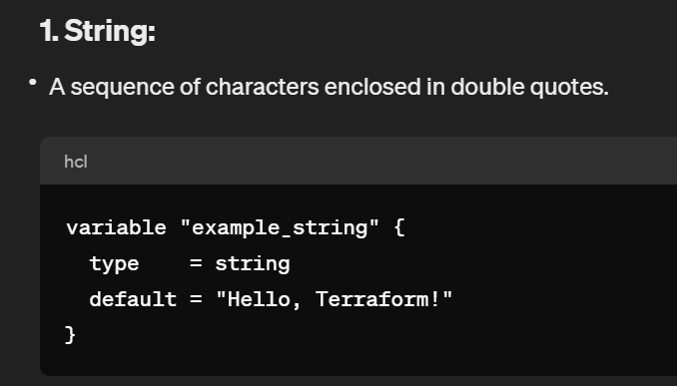
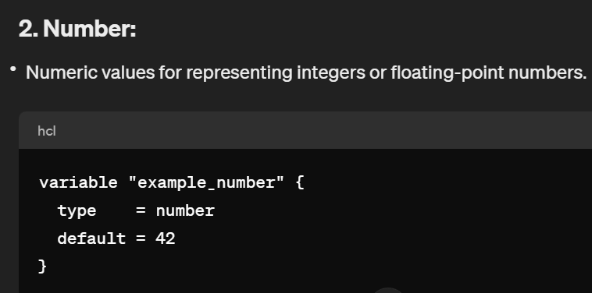
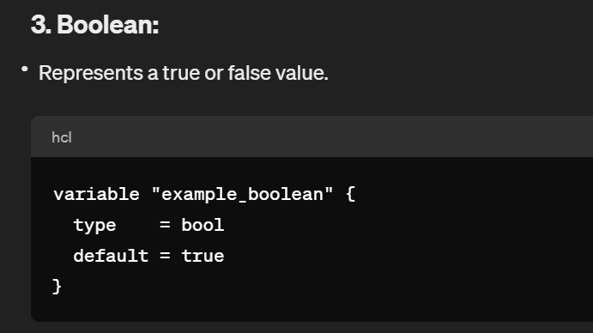
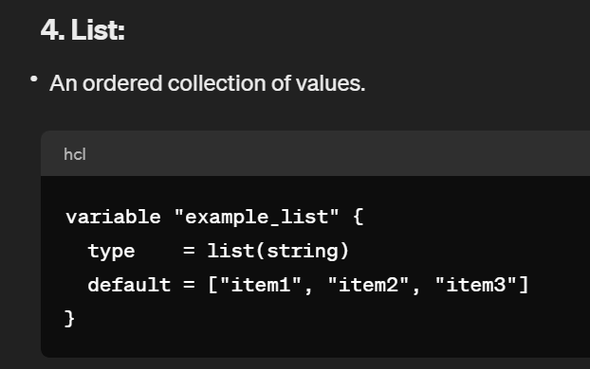
Input Variables

Slide 14
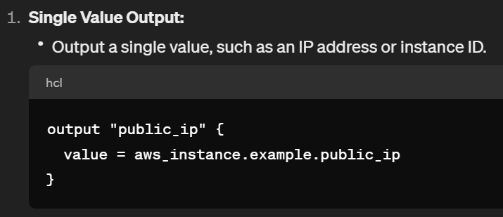
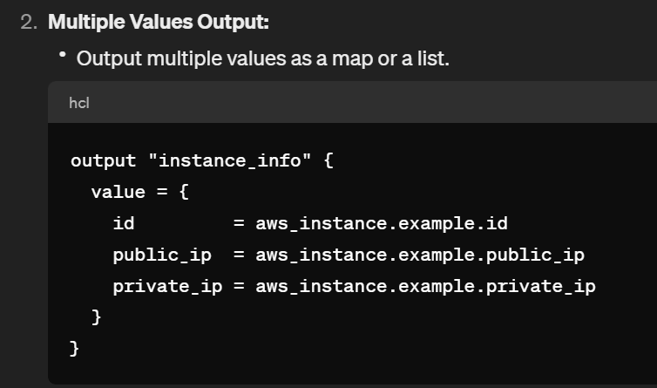
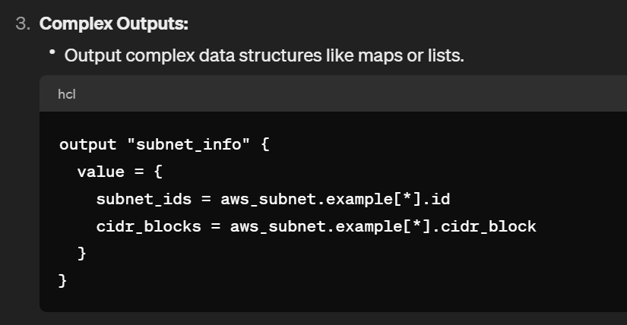
Output Variables

Slide 15
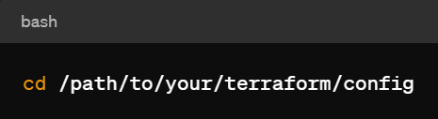
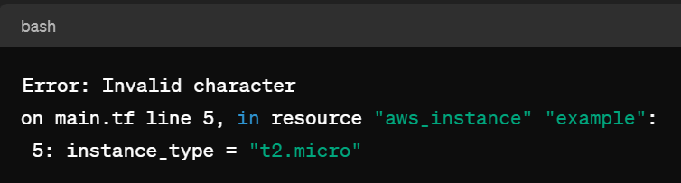
Terraform Validate
The terraform validate command is used to check the syntax and validity of your Terraform configuration files.
Open a terminal or command prompt on your machine.
Change your current working directory to the directory containing your Terraform configuration files.
Run terraform validate
If your configuration is correct, Terraform will return nothing. If there are errors, it will provide feedback on what needs to be corrected.

Slide 16
Create an EC2 Instance using Terraform

Slide 17
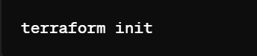

STEPS
Install Terraform
Configure AWS Credentials
Create a Terraform Configuration File
Initialize Terraform
Review Terraform Plan - command to see what changes Terraform will make. Terraform will display a summary of the resources it plans to create.

Slide 18


Steps Continues..
Apply Changes - If the plan looks good, apply the changes
Confirm by typing "yes" when prompted. Terraform will create the EC2 instance.
Destroy Resources - destroy the resources created by Terraform
Confirm by typing "yes" when prompted

Slide 19
Main.tf file: // Replace the region, ami, and instance_type with your preferred values.
# main.tf
# Configure AWS provider
provider "aws" {
region = "us-west-2" # Update with your desired AWS region
}
# Define an EC2 instance
resource "aws_instance" "example" {
ami = "ami-0c55b159cbfafe1f0" # Amazon Linux 2 AMI ID (update as needed)
instance_type = "t2.micro" # Update with your desired instance type
tags = {
Name = "example-instance"
}
}

Slide 20
THANK YOU

